Slide 1
Digital Portfolio
STUDENT NAME:HARISH.A
REGISTERN NO AND NMID:198A7440CC989AA934241385F8EA27F8
DEPARTMENT:BSC
COLLEGE:Prince shri Balaji arts and science college/university of MADRAS

Slide 2
PROJECT TITLE
STUDENT DIGITAL PORTFOLIO

Slide 3
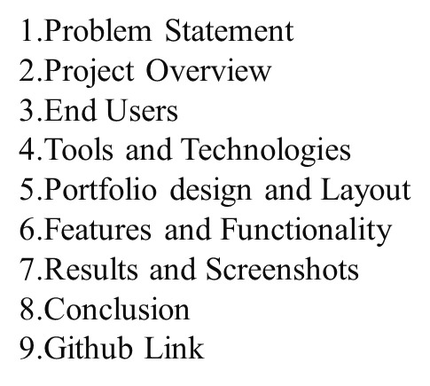
AGENDA

Slide 4
PROBLEM STATEMENT
In today’s digital era, many students struggle to effectively showcase their skills, academic achievements, and personal growth in a structured and accessible way. Traditional methods, such as paper files or basic resumes, often fail to represent a student’s full potential and are difficult to update or share.
There is a growing need for a digital platform where students can organize, display, and share their work easily with teachers, peers, colleges, and employers

Slide 5
PROJECTOVERVIEW
This project is a personal portfolio website created using HTML, CSS , and JavaScript.
It showcases my profile, skills, and projects with a clean and responsive design.
The site includes sections like About Me, My Projects, and a Contact Form for easy interaction.
It serves as a platform to highlight my web development learning journey and projects.

Slide 6
WHO ARE THE END USERS?
If the end users are students, they could be:
Classmates or friends – who want to see your projects for ideas or inspiration.
Team members – collaborating with you on group projects or hackathons.
Junior students – learning from your code and portfolio structure.
Peers in tech communities – connecting for networking, knowledge sharing, or project collaboration

Slide 7
TOOLS AND TECHNIQUES
HTML – to structure the content of the website.
CSS – for styling, layout, and color themes.
JavaScript – for interactivity, such as the menu toggle and form behavior
Mention code editor CODEPEN (GitHub Pages))

Slide 8
POTFOLIO DESIGN AND LAYOUT
Header – Links for Home, About, Projects, and Contact.
Hero Section – Introduction with your name, tagline, and a "View My Work" button.
About Me Section – Profile photo, brief bio, and academic details.
Projects Section – Cards for Project 1, Project 2, and Project 3 with short descriptions.
Contact Form – Simple form with fields for name, email, and message plus a send button.

Slide 9
FEATURES AND FUNCTIONALITY
Responsive Design – Works smoothly on mobile, tablet, and desktop devices
Clean Navigation – Easy-to-use menu for quick access to sections like About, Projects, and Contact.
Interactive UI – Buttons and links with hover effects for a modern look.
Smooth Scrolling – Seamless transition between sections when clicking navigation links.
Clickable Links – Projects link to live demos or code repositories

Slide 10
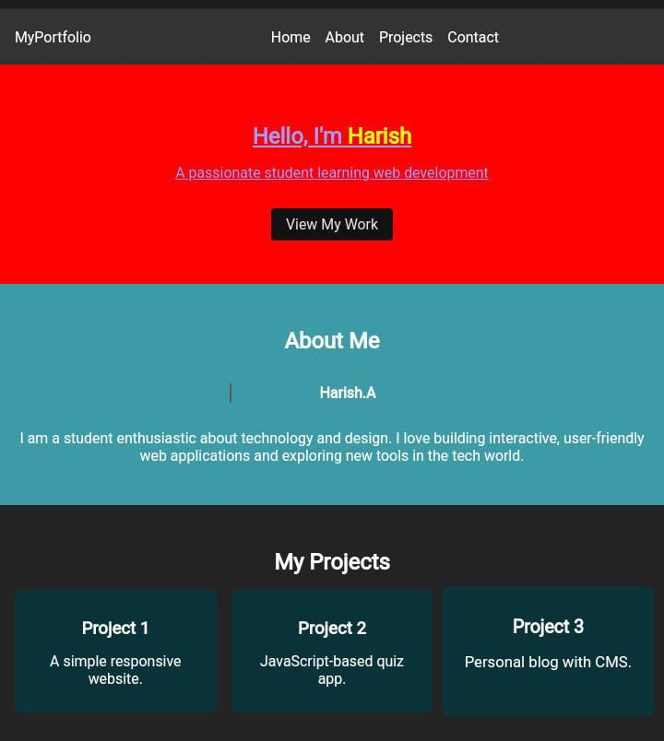
RESULTS AND SCREENSHOTS

Slide 11
CONCLUSION
This portfolio project effectively showcases my skills, projects, and learning journey in web development .It provides a clean, responsive, and user-friendly platform for students, recruiters, and peers to explore my work . Through this project, I have gained practical experience in HTML, CSS, and JavaScript, as well as in responsive design techniques. This portfolio will continue to grow and improve as I enhance my skills and complete more projects

